Slide 1
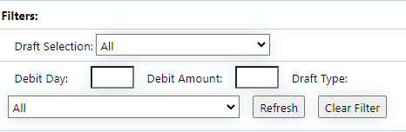
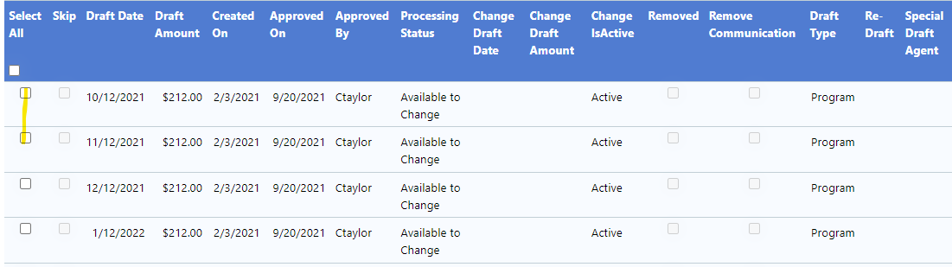

Making a Draft Change
Reviewed 9/21/2023
Confirm that drafts will process
Check to see if there are any pending payments in the schedule (in green)
If yes, go to Client Creditor and Simultaneous Settlement tab and select the Enrolled $ hyperlink of a different creditor (this allows only finalized payments to show and accurate calculator)
If yes, continue
If no, create a new SPAA
Click Draft Change tab
If no, continue
Filter drafts using debit day, debit amount, and/or draft type filters if changing multiple drafts, then click refresh
Select drafts that the client wants to change (if changing all, select all)
From slides 3-4, follow the steps for the draft change, then go to slide 6 for steps to finalize.
Please note you can only make 1 of the following draft changes at a time. You must finalize and then start again if changing multiple things about a draft (ex. A date and amount)

Slide 2
Important for any client requesting to skip/reduce draft
All drafts in the schedule are needed, so instead of skipping a draft always, at minimum, move to end of program and advise client the reason.
Educate client on the importance of keeping drafting in place and encourage to do so.
If client is unable to do full draft, use discover questions to determine how much they can draft and offer to split the draft.
Always encourage client to make what the minimum amount would be for payments, BLP charge, and/or fees owed.
If client cannot do any amount at this time, use discover questions to determine when the client can draft and move to that date.
Always attempt to keep draft as close to original draft date as possible.
If client is unable to commit to any amount and date, move draft to end of program.

Slide 3
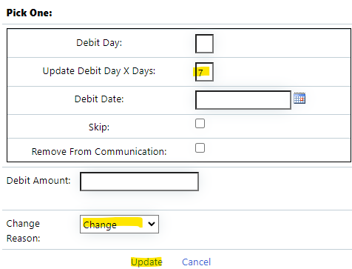
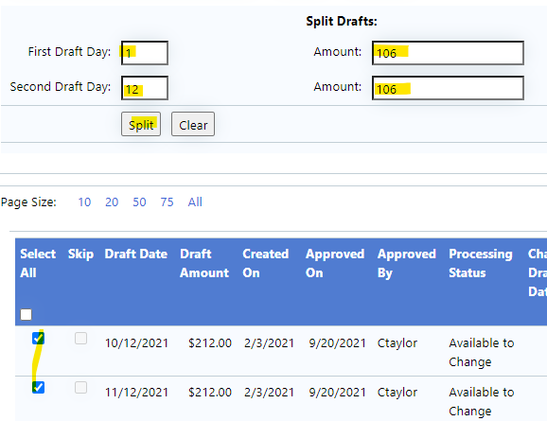
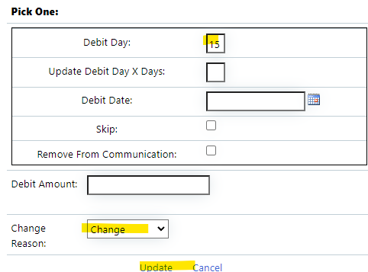
Client wishes to….
1. Click the Split drafts button
2. Select the draft(s) you are looking to split
3. Fill out the table with the first and second draft day and the amounts for each.
4. Click Split
Split Draft
1. Select the draft(s) that your client is wishing to move to a new date
2. Type in the day that the client wishes for the draft(s) to come out on in the Debit Day field
3. Select Change Reason from drop down
4. Click update hyperlink
Move drafts to a new date
1. Select the draft(s) that your client is wishing to move to a new date
2. Type in the number of days the client wishes for the draft(s) to pushed out in the Update Debit Day X Days field
3. Select Change Reason from drop down
4. Click update hyperlink
Move drafts by a specific number of days
note that the total of the split draft must equal the original draft amount
Used if client wishes to push date out by 5 days (or x number of days)

Slide 4
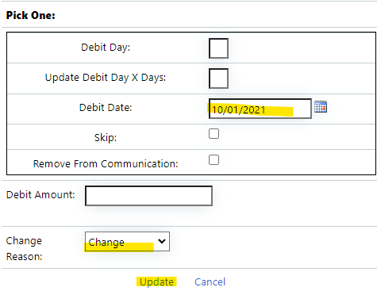
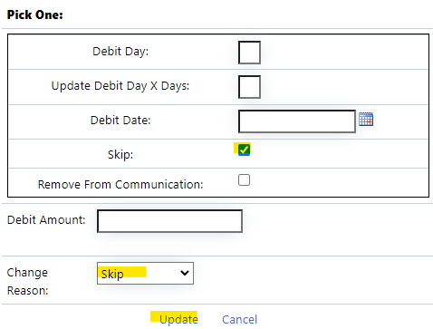
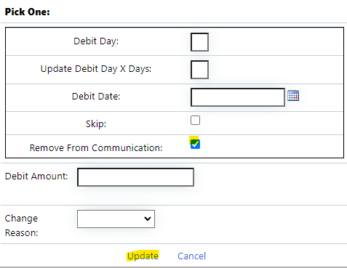
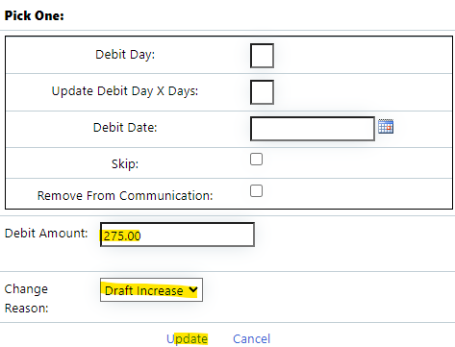
Client wishes to….
1. Select the draft that your client is wishing to move to a new date
2. Type in the day that the client wishes for the draft to come out on in the Debit Date field
3. Select Change Reason from drop down
4. Click update hyperlink
Moves one draft to a specific date
1. Select the draft(s) that your client is wishing to remove from communication
2. Select the Remove from Communication checkbox
4. Click update hyperlink
Request we stop contacting them regarding an NSF draft
1. Select the draft(s) that your client is wishing to increase or decrease
2. Type in the amount of the new draft in the debit amount field
3. Select Change Reason from drop down
4. Click update hyperlink
Change their draft amount
You can only use this selection when only 1 draft is selected to change
1. Select the draft(s) that your client is wishing to skip
2. Select the Skip checkbox
3. Select skip from Change Reason from drop down
4. Click update hyperlink
**If client is BLP enrolled, they are not able to skip. Check to see if they will draft $29.95 to cover the fee. If they cannot, move the draft to the last program draft date.
Skip Drafts
You would need to do this for any missed draft that you discuss that the client is unable to make up, in order to remove the client from the dialer

Slide 5
Finalize Draft Changes
Scroll down to Client Balance Schedule
Click the Historical Balance Saved tab and click Save Balance Button
Click DL Global Data & Recalculate
Refresh and scroll through the entire calculator to ensure this change doesn’t negatively impact a settlement (at any time)
If settlements are affected advise client that settlement(s) will be impacted and attempt to do a minimum of a partial draft.
If no settlement are affected, continue.
Obtain confirmation recording
Scroll to top of Draft Changes tab and re-select all drafts that are pending finalization
Scroll back down to Client Balance Schedule and Click DL Global Data & Recalculate
Click Finalize
Always ensure recording has uploaded to client files and add notes to client page
Exception: If a client wants to lower all program drafts, you must submit a Program Change to modify program terms

